Slide 1
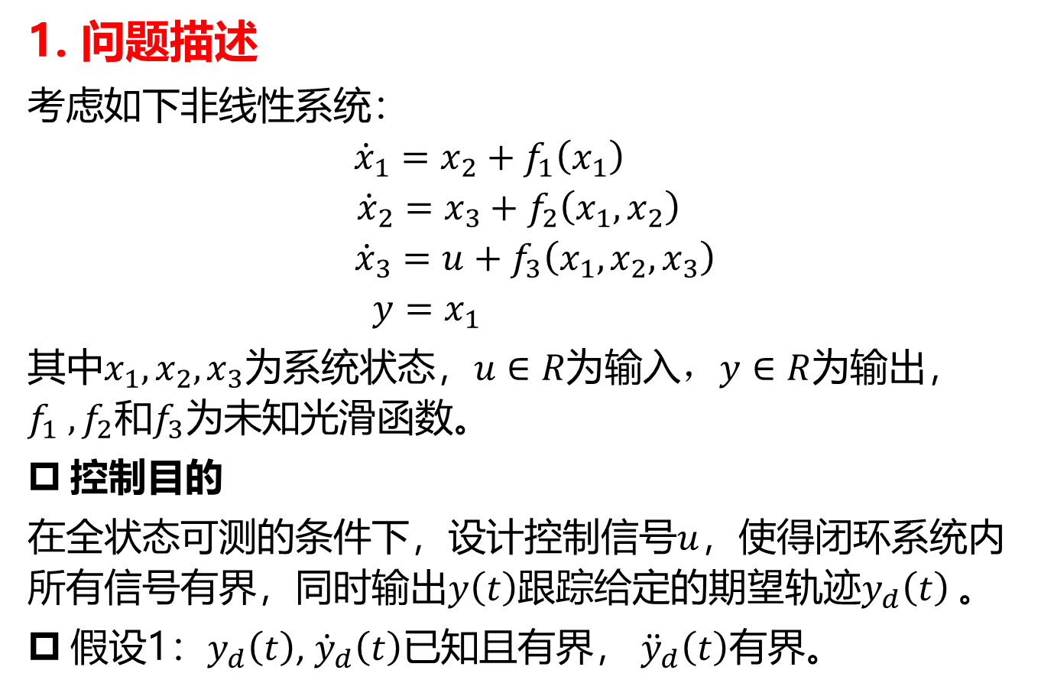
1. 问题描述
考虑如下非线性系统：
$${\dot{x}}_{1}=x_{2}+f_{1}\left(x_{1}\right)$$
$${\dot{x}}_{2}=x_{3}+f_{2}\left(x_{1},x_{2}\right)$$
$${\dot{x}}_{3}=u+f_{3}\left(x_{1},x_{2},x_{3}\right)$$
$$y=x_{1}$$
其中$x_{1},x_{2},x_{3}$为系统状态，$u∈R为$输入$，y∈R$为输出， $f_{1} ,f_{2}和f_{3}$为未知光滑函数。
控制目的
在全状态可测的条件下，设计控制信号$u$，使得闭环系统内所有信号有界，同时输出$y\left(t\right)$跟踪给定的期望轨迹$y_{d}\left(t\right)$。
假设1：$y_{d}\left(t\right)$, ${\dot{y}}_{d}\left(t\right)$已知且有界， ${\ddot{y}}_{d}\left(t\right)有界。$

Slide 2
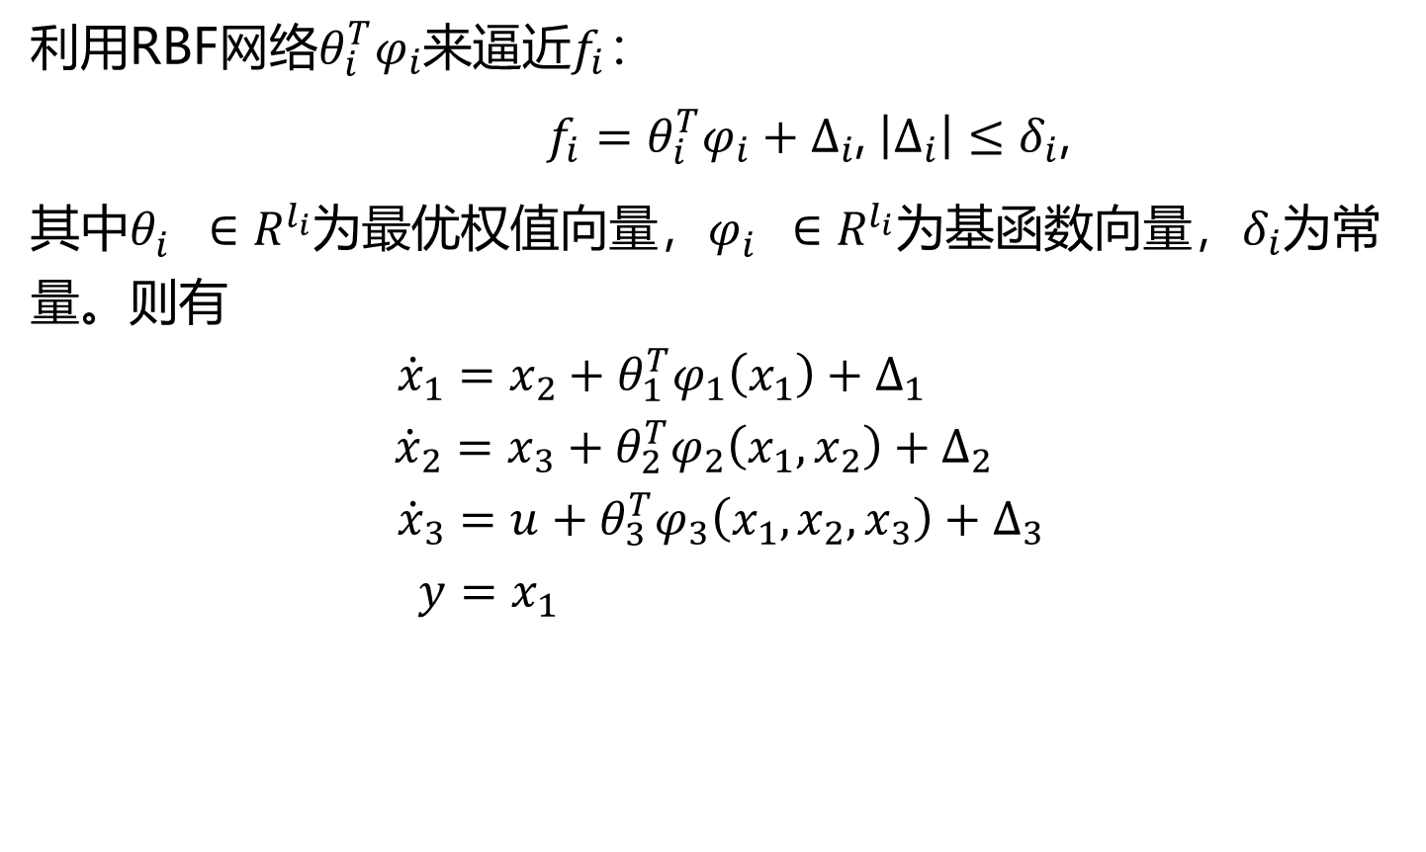
利用RBF网络$θ_{i}^{T}φ_{i}$来逼近$f_{i}$：
$f_{i}=θ_{i}^{T}φ_{i}+∆_{i}$, $\left|∆_{i}\right|≤δ_{i}$,
其中$θ_{i}^{}∈R^{l_{i}}为最优权值向量，φ_{i}^{}∈R^{l_{i}}为基函数向量，δ_{i}$为常量。则有
$${\dot{x}}_{1}=x_{2}+θ_{1}^{T}φ_{1}\left(x_{1}\right)+∆_{1}$$
$${\dot{x}}_{2}=x_{3}+θ_{2}^{T}φ_{2}\left(x_{1},x_{2}\right)+∆_{2}$$
$${\dot{x}}_{3}=u+θ_{3}^{T}φ_{3}\left(x_{1},x_{2},x_{3}\right)+∆_{3}$$
$$y=x_{1}$$

Slide 3
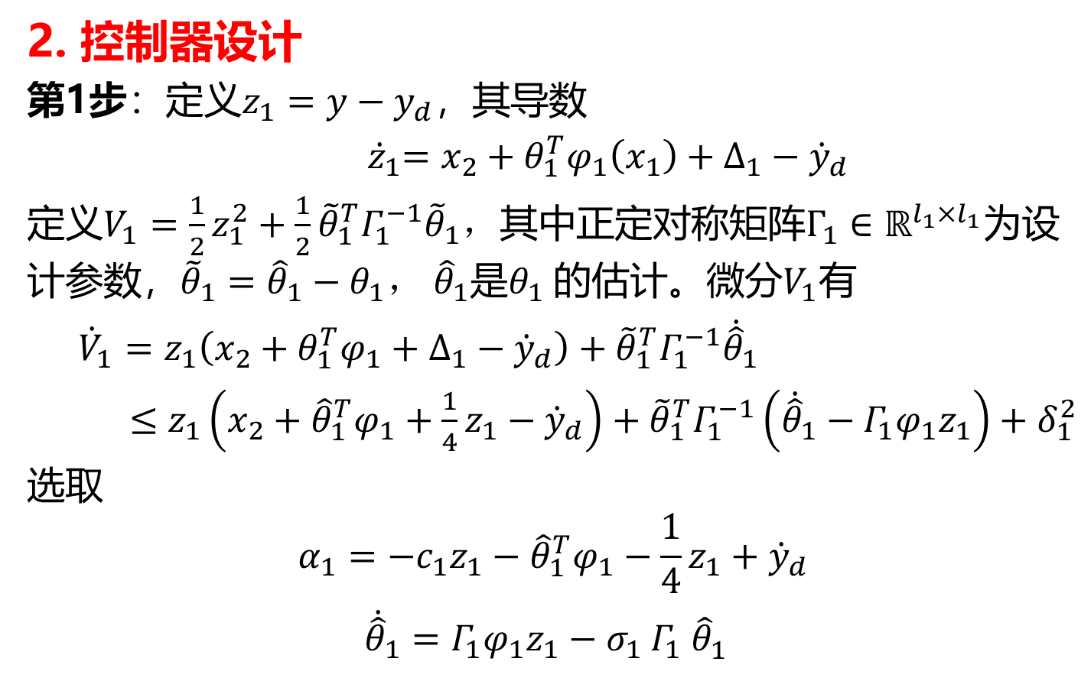
2. 控制器设计
第1步：定义${z_{1}=y−y}_{d}$，其导数
${ \dot{z}}_{1}=x_{2}+θ_{1}^{T}φ_{1}\left(x_{1}\right)+∆_{1}−{\dot{y}}_{d}$
定义$V_{1}=\frac{1}{2}z_{1}^{2}+\frac{1}{2}{\tilde{θ}}_{1}^{T}Γ_{1}^{−1}{\tilde{θ}}_{1}，$其中正定对称矩阵$Γ_{1}∈ℝ^{l_{1}×l_{1}}$为设计参数，${\tilde{θ}}_{1}={\hat{θ}}_{1}−θ_{1}，$ ${\hat{θ}}_{1}$是$θ_{1}$的估计。微分$V_{1}$有
${\dot{V}}_{1}=z_{1}\left(x_{2}+θ_{1}^{T}φ_{1}+∆_{1}−{\dot{y}}_{d}\right)+{\tilde{θ}}_{1}^{T}Γ_{1}^{−1}{\dot{\hat{θ}}}_{1}$
$≤$ $z_{1}\left(x_{2}+{\hat{θ}}_{1}^{T}φ_{1}+\frac{1}{4}z_{1}−{\dot{y}}_{d}\right)+{\tilde{θ}}_{1}^{T}Γ_{1}^{−1}\left({\dot{\hat{θ}}}_{1}−Γ_{1}φ_{1}z_{1}\right)+δ_{1}^{2}$
选取
$$α_{1}=−c_{1}z_{1}−{\hat{θ}}_{1}^{T}φ_{1}−\frac{1}{4}z_{1}+{\dot{y}}_{d}$$
${\dot{\hat{θ}}}_{1}=Γ_{1}φ_{1}z_{1}−σ_{1}$ $Γ_{1}$ ${\hat{θ}}_{1}^{}$

Slide 4
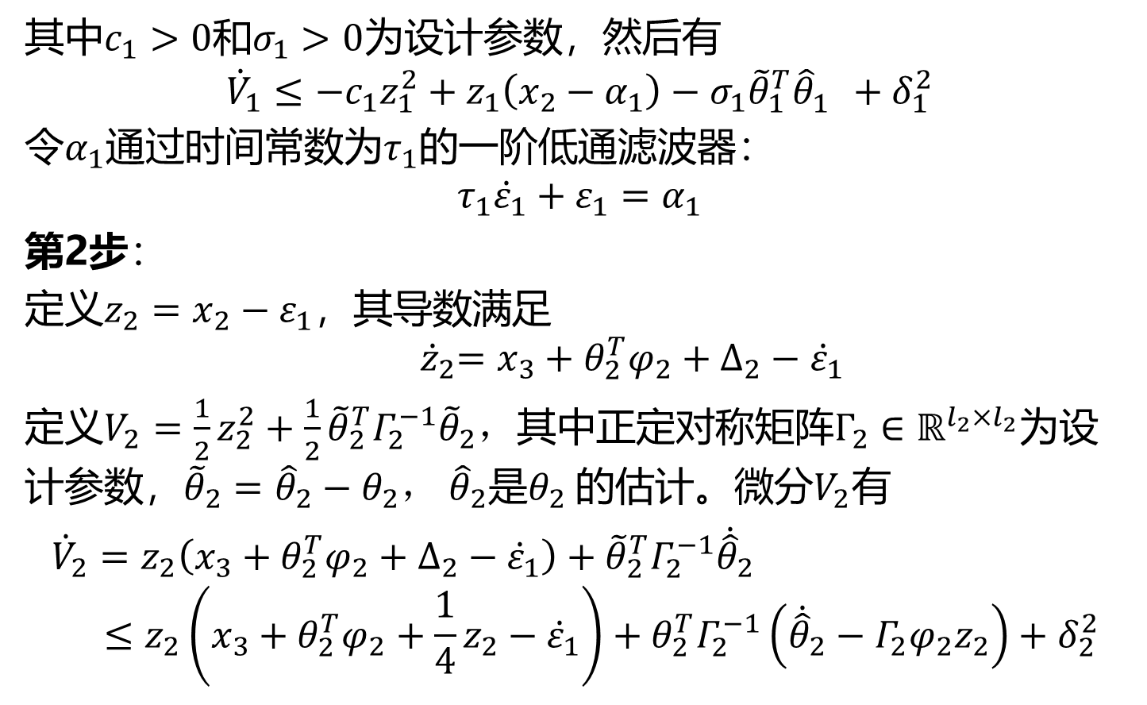
其中$c_{1}>0$和$σ_{1}>0$为设计参数，然后有
$${\dot{V}}_{1}≤−c_{1}z_{1}^{2}+z_{1}\left(x_{2}−α_{1}\right)−σ_{1}{\tilde{θ}}_{1}^{T}{\hat{θ}}_{1}^{}+δ_{1}^{2}$$
令$α_{1}$通过时间常数为$τ_{1}$的一阶低通滤波器：
$$τ_{1}{\dot{ε}}_{1}+ε_{1}=α_{1}$$
第2步：
定义$z_{2}=x_{2}−ε_{1}$，其导数满足
$${ \dot{z}}_{2}=x_{3}+θ_{2}^{T}φ_{2}+∆_{2}−{\dot{ε}}_{1}$$
定义$V_{2}=\frac{1}{2}z_{2}^{2}+\frac{1}{2}{\tilde{θ}}_{2}^{T}Γ_{2}^{−1}{\tilde{θ}}_{2}，$其中正定对称矩阵$Γ_{2}∈ℝ^{l_{2}×l_{2}}$为设计参数，${\tilde{θ}}_{2}={\hat{θ}}_{2}−θ_{2}，$ ${\hat{θ}}_{2}$是$θ_{2}$的估计。微分$V_{2}$有
${\dot{V}}_{2}=z_{2}\left(x_{3}+θ_{2}^{T}φ_{2}+∆_{2}−{\dot{ε}}_{1}\right)+{\tilde{θ}}_{2}^{T}Γ_{2}^{−1}{\dot{\hat{θ}}}_{2}$
$$≤z_{2}\left(x_{3}+θ_{2}^{T}φ_{2}+\frac{1}{4}z_{2}−{\dot{ε}}_{1}\right)+θ_{2}^{T}Γ_{2}^{−1}\left({\dot{\hat{θ}}}_{2}−Γ_{2}φ_{2}z_{2}\right)+δ_{2}^{2}$$

Slide 5
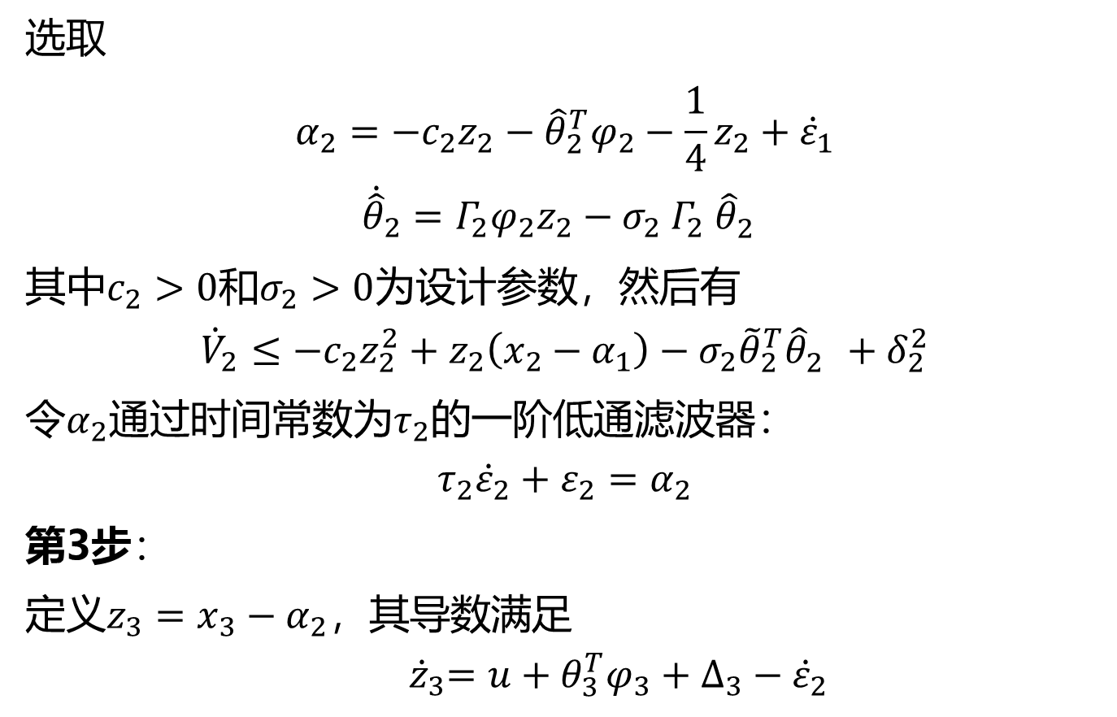
选取
$$α_{2}=−c_{2}z_{2}−{\hat{θ}}_{2}^{T}φ_{2}−\frac{1}{4}z_{2}+{\dot{ε}}_{1}$$
${\dot{\hat{θ}}}_{2}=Γ_{2}φ_{2}z_{2}−σ_{2}$ $Γ_{2}$ ${\hat{θ}}_{2}^{}$
其中$c_{2}>0$和$σ_{2}>0$为设计参数，然后有
$${\dot{V}}_{2}≤−c_{2}z_{2}^{2}+z_{2}\left(x_{2}−α_{1}\right)−σ_{2}{\tilde{θ}}_{2}^{T}{\hat{θ}}_{2}^{}+δ_{2}^{2}$$
令$α_{2}$通过时间常数为$τ_{2}$的一阶低通滤波器：
$$τ_{2}{\dot{ε}}_{2}+ε_{2}=α_{2}$$
第3步：
定义$z_{3}=x_{3}−α_{2}$，其导数满足
$${ \dot{z}}_{3}=u+θ_{3}^{T}φ_{3}+∆_{3}−{\dot{ε}}_{2}$$

Slide 6
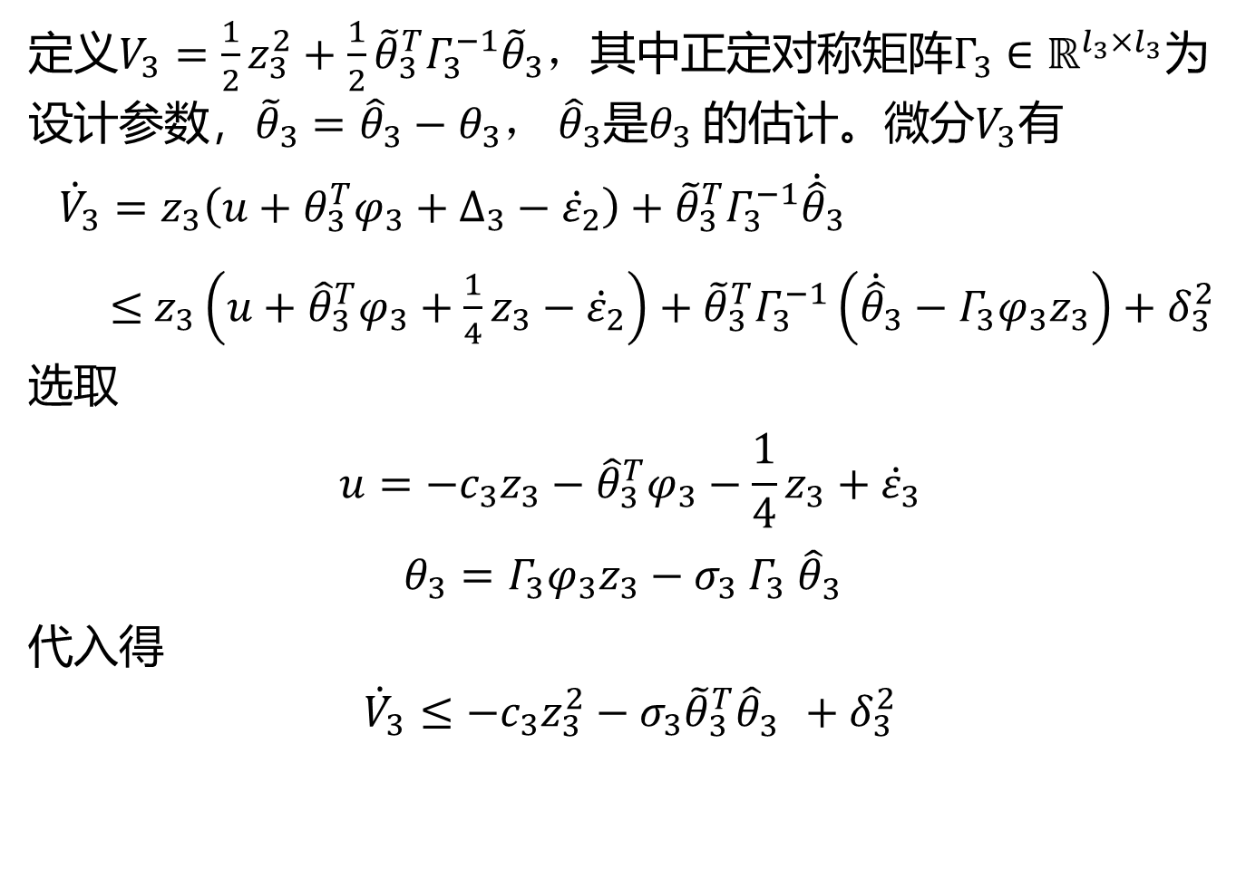
定义$V_{3}=\frac{1}{2}z_{3}^{2}+\frac{1}{2}{\tilde{θ}}_{3}^{T}Γ_{3}^{−1}{\tilde{θ}}_{3}，$其中正定对称矩阵$Γ_{3}∈ℝ^{l_{3}×l_{3}}$为设计参数，${\tilde{θ}}_{3}={\hat{θ}}_{3}−θ_{3}，$ ${\hat{θ}}_{3}$是$θ_{3}$的估计。微分$V_{3}$有
${\dot{V}}_{3}=z_{3}\left(u+θ_{3}^{T}φ_{3}+∆_{3}−{\dot{ε}}_{2}\right)+{\tilde{θ}}_{3}^{T}Γ_{3}^{−1}{\dot{\hat{θ}}}_{3}$
$≤$ $z_{3}\left(u+{\hat{θ}}_{3}^{T}φ_{3}+\frac{1}{4}z_{3}−{\dot{ε}}_{2}\right)+{\tilde{θ}}_{3}^{T}Γ_{3}^{−1}\left({\dot{\hat{θ}}}_{3}−Γ_{3}φ_{3}z_{3}\right)+δ_{3}^{2}$
选取
$$u=−c_{3}z_{3}−{\hat{θ}}_{3}^{T}φ_{3}−\frac{1}{4}z_{3}+{\dot{ε}}_{3}$$
$θ_{3}=Γ_{3}φ_{3}z_{3}−σ_{3}$ $Γ_{3}$ ${\hat{θ}}_{3}^{}$
代入得
$${\dot{V}}_{3}≤−c_{3}z_{3}^{2}−σ_{3}{\tilde{θ}}_{3}^{T}{\hat{θ}}_{3}^{}+δ_{3}^{2}$$

Slide 7
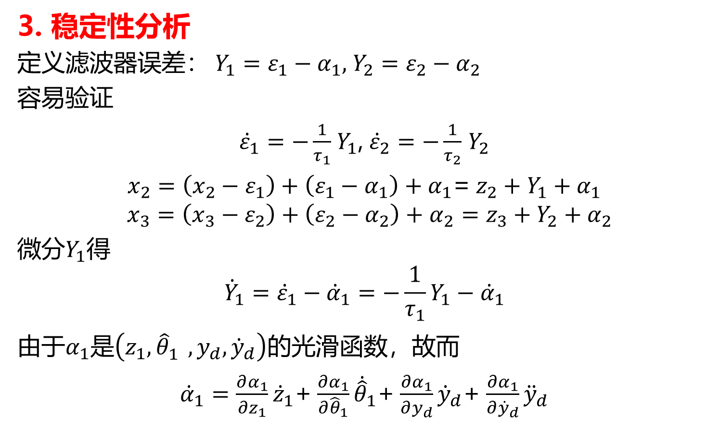
3. 稳定性分析
定义滤波器误差： $Y_{1}=ε_{1}−α_{1}$, $Y_{2}=ε_{2}−α_{2}$
容易验证
${\dot{ε}}_{1}=−\frac{1}{τ_{1}}$ $Y_{1}$, ${\dot{ε}}_{2}=−\frac{1}{τ_{2}}$ $Y_{2}$
$x_{2}=\left(x_{2}−ε_{1}\right)+\left(ε_{1}−α_{1}\right)+$ $α_{1}$= $z_{2}+Y_{1}+α_{1}$
$$x_{3}=\left(x_{3}−ε_{2}\right)+\left(ε_{2}−α_{2}\right)+α_{2}=z_{3}+Y_{2}+α_{2}$$
微分$Y_{1}$得
$${\dot{Y}}_{1}={\dot{ε}}_{1}−{\dot{α}}_{1}=−\frac{1}{τ_{1}}Y_{1}−{\dot{α}}_{1}$$
由于$α_{1}$是$\left(z_{1},{\hat{θ}}_{1}^{},y_{d},{\dot{y}}_{d}\right)的$光滑函数，故而
${\dot{α}}_{1}=\frac{∂α_{1}}{∂z_{1}}{\dot{z}}_{1}$+ $\frac{∂α_{1}}{∂{\hat{θ}}_{1}}{\dot{\hat{θ}}}_{1}$+ $\frac{∂α_{1}}{∂y_{d}}{\dot{y}}_{d}$+ $\frac{∂α_{1}}{∂{\dot{y}}_{d}}{\ddot{y}}_{d}$

Slide 8
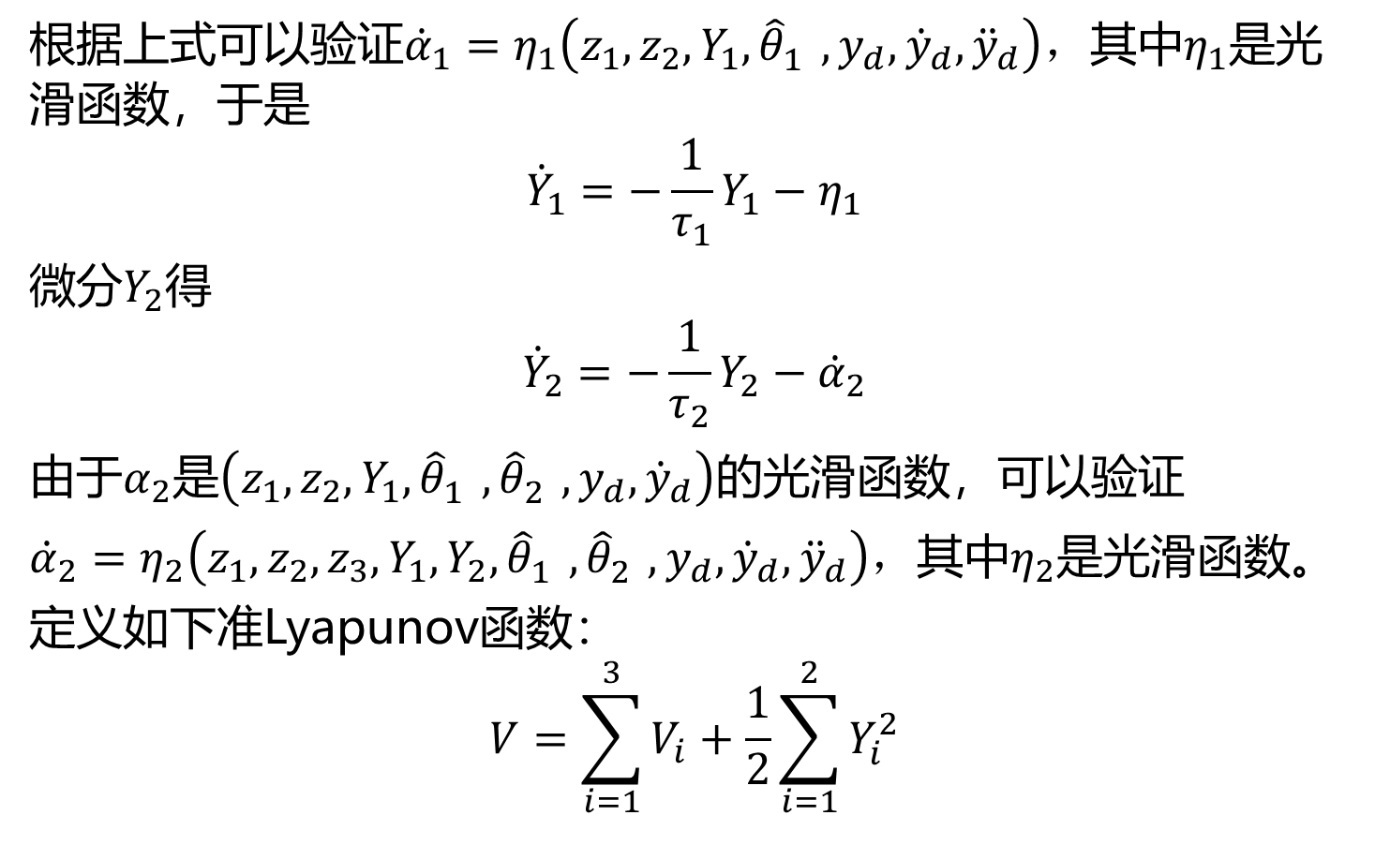
根据上式可以验证${\dot{α}}_{1}=η_{1}\left(z_{1},z_{2},Y_{1},{\hat{θ}}_{1}^{},y_{d},{\dot{y}}_{d},{\ddot{y}}_{d}\right)，$其中$η_{1}$是光滑函数，于是
$${\dot{Y}}_{1}=−\frac{1}{τ_{1}}Y_{1}−η_{1}$$
微分$Y_{2}$得
$${\dot{Y}}_{2}=−\frac{1}{τ_{2}}Y_{2}−{\dot{α}}_{2}$$
由于$α_{2}$是$\left(z_{1},z_{2},Y_{1},{\hat{θ}}_{1}^{},{\hat{θ}}_{2}^{},y_{d},{\dot{y}}_{d}\right)的$光滑函数，可以验证
${\dot{α}}_{2}=η_{2}\left(z_{1},z_{2},z_{3},Y_{1},Y_{2},{\hat{θ}}_{1}^{},{\hat{θ}}_{2}^{},y_{d},{\dot{y}}_{d},{\ddot{y}}_{d}\right)，$其中$η_{2}$是光滑函数。
定义如下准Lyapunov函数：
$$V=\sum_{i=1}^{3}{V_{i}}+\frac{1}{2}\sum_{i=1}^{2}{Y_{i}^{2}}$$

Slide 9
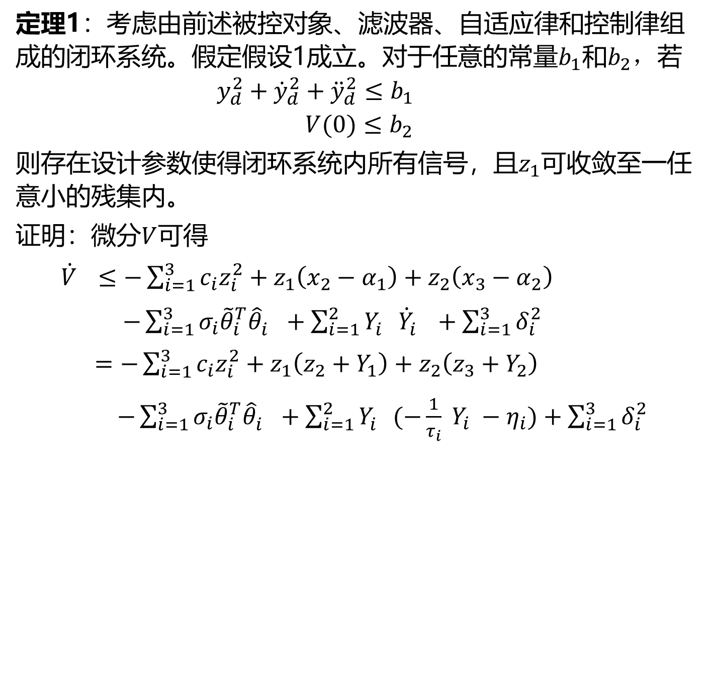
定理1：考虑由前述被控对象、滤波器、自适应律和控制律组成的闭环系统。假定假设1成立。对于任意的常量$b_{1}$和$b_{2}，$若
$$y_{d}^{2}+{\dot{y}}_{d}^{2}+{\ddot{y}}_{d}^{2}≤b_{1}$$
$$V(0)≤b_{2}$$
则存在设计参数使得闭环系统内所有信号，且$z_{1}可$收敛至一任意小的残集内。
证明：微分$V$可得
${\dot{V}}_{}≤−\sum_{i=1}^{3}{c_{i}z_{i}^{2}}+z_{1}\left(x_{2}−α_{1}\right)+z_{2}\left(x_{3}−α_{2}\right)$
$−\sum_{i=1}^{3}{σ_{i}{\tilde{θ}}_{i}^{T}{\hat{θ}}_{i}^{}}+\sum_{i=1}^{2}{Y_{i}^{}{\dot{Y}}_{i}^{}}+\sum_{i=1}^{3}{δ_{i}^{2}}$
$=−\sum_{i=1}^{3}{c_{i}z_{i}^{2}}+z_{1}\left(z_{2}+Y_{1}\right)+z_{2}\left(z_{3}+Y_{2}\right)$
$−\sum_{i=1}^{3}{σ_{i}{\tilde{θ}}_{i}^{T}{\hat{θ}}_{i}^{}}+\sum_{i=1}^{2}{Y_{i}^{}(−\frac{1}{τ_{i}} Y_{i} −η_{i})}+\sum_{i=1}^{3}{δ_{i}^{2}}$

Slide 10
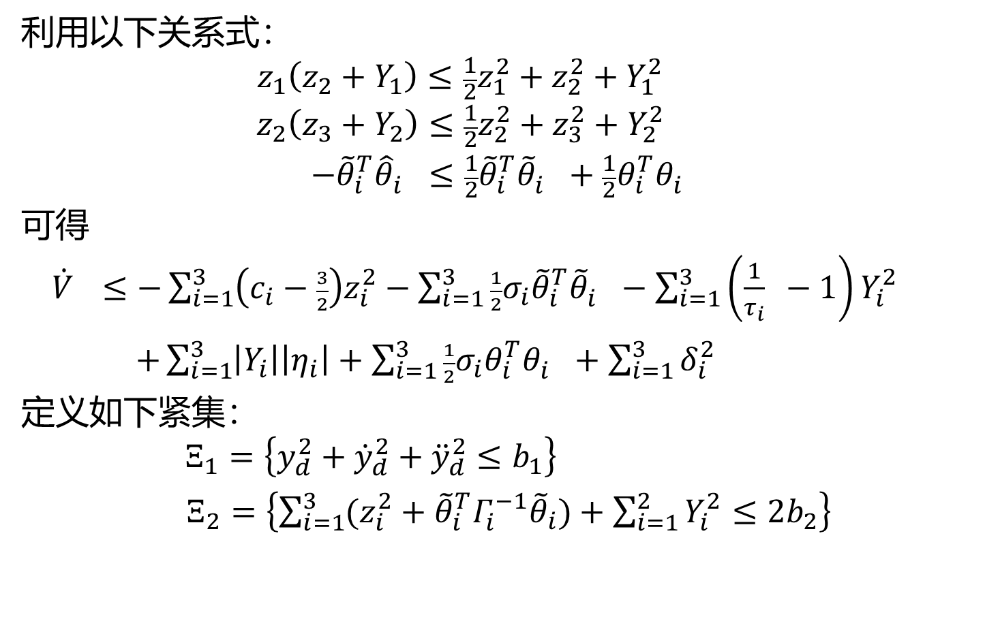
利用以下关系式：
$$z_{1}\left(z_{2}+Y_{1}\right)≤\frac{1}{2}z_{1}^{2}+z_{2}^{2}+Y_{1}^{2}$$
$$z_{2}\left(z_{3}+Y_{2}\right)≤\frac{1}{2}z_{2}^{2}+z_{3}^{2}+Y_{2}^{2}$$
$$−{\tilde{θ}}_{i}^{T}{\hat{θ}}_{i}^{}≤\frac{1}{2}{\tilde{θ}}_{i}^{T}{\tilde{θ}}_{i}^{}+\frac{1}{2}θ_{i}^{T}θ_{i}^{}$$
可得
${\dot{V}}_{}≤−\sum_{i=1}^{3}{\left(c_{i}−\frac{3}{2}\right)z_{i}^{2}}−\sum_{i=1}^{3}{\frac{1}{2}σ_{i}{\tilde{θ}}_{i}^{T}{\tilde{θ}}_{i}^{}}−\sum_{i=1}^{3}{\left(\frac{1}{τ_{i}} −1\right)Y_{i}^{2}}$
$+\sum_{i=1}^{3}{\left|Y_{i}\right|\left|η_{i}\right|}+\sum_{i=1}^{3}{\frac{1}{2}σ_{i}θ_{i}^{T}θ_{i}^{}}+\sum_{i=1}^{3}{δ_{i}^{2}}$
定义如下紧集：
$$Ξ_{1}=\left\{y_{d}^{2}+{\dot{y}}_{d}^{2}+{\ddot{y}}_{d}^{2}≤b_{1}\right\}$$
$Ξ_{2}=\left\{\sum_{i=1}^{3}{(z_{i}^{2}+{\tilde{θ}}_{i}^{T}Γ_{i}^{−1}{\tilde{θ}}_{i})}+\sum_{i=1}^{2}{Y_{i}^{2}}≤2b_{2}\right\}$

Slide 11
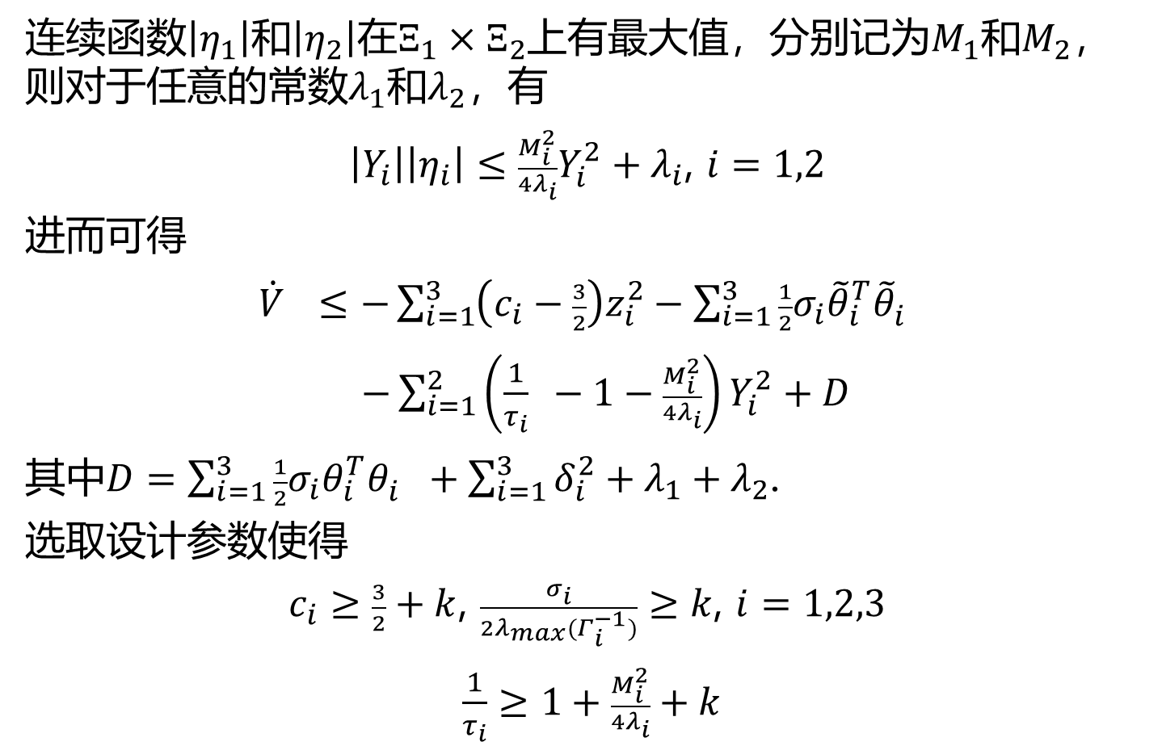
连续函数$\left|η_{1}\right|$和$\left|η_{2}\right|$在$Ξ_{1}×Ξ_{2}$上有最大值，分别记为$M_{1}$和$M_{2}$，则对于任意的常数$λ_{1}$和$λ_{2}$，有
$\left|Y_{i}\right|\left|η_{i}\right|≤\frac{M_{i}^{2}}{4λ_{i}}Y_{i}^{2}+λ_{i}$, $i=1,2$
进而可得
${\dot{V}}_{}≤−\sum_{i=1}^{3}{\left(c_{i}−\frac{3}{2}\right)z_{i}^{2}}−\sum_{i=1}^{3}{\frac{1}{2}σ_{i}{\tilde{θ}}_{i}^{T}{\tilde{θ}}_{i}^{}}$
$−\sum_{i=1}^{2}{\left(\frac{1}{τ_{i}} −1−\frac{M_{i}^{2}}{4λ_{i}}\right)Y_{i}^{2}}+D$
其中$D=\sum_{i=1}^{3}{\frac{1}{2}σ_{i}θ_{i}^{T}θ_{i}^{}}+\sum_{i=1}^{3}{δ_{i}^{2}}+λ_{1}+λ_{2}$.
选取设计参数使得
$c_{i}≥\frac{3}{2}+k$, $\frac{σ_{i}}{2λ_{max}(Γ_{i}^{−1})}≥k$, $i=1,2,3$
$\frac{1}{τ_{i}}≥1+\frac{M_{i}^{2}}{4λ_{i}}+k$

Slide 12
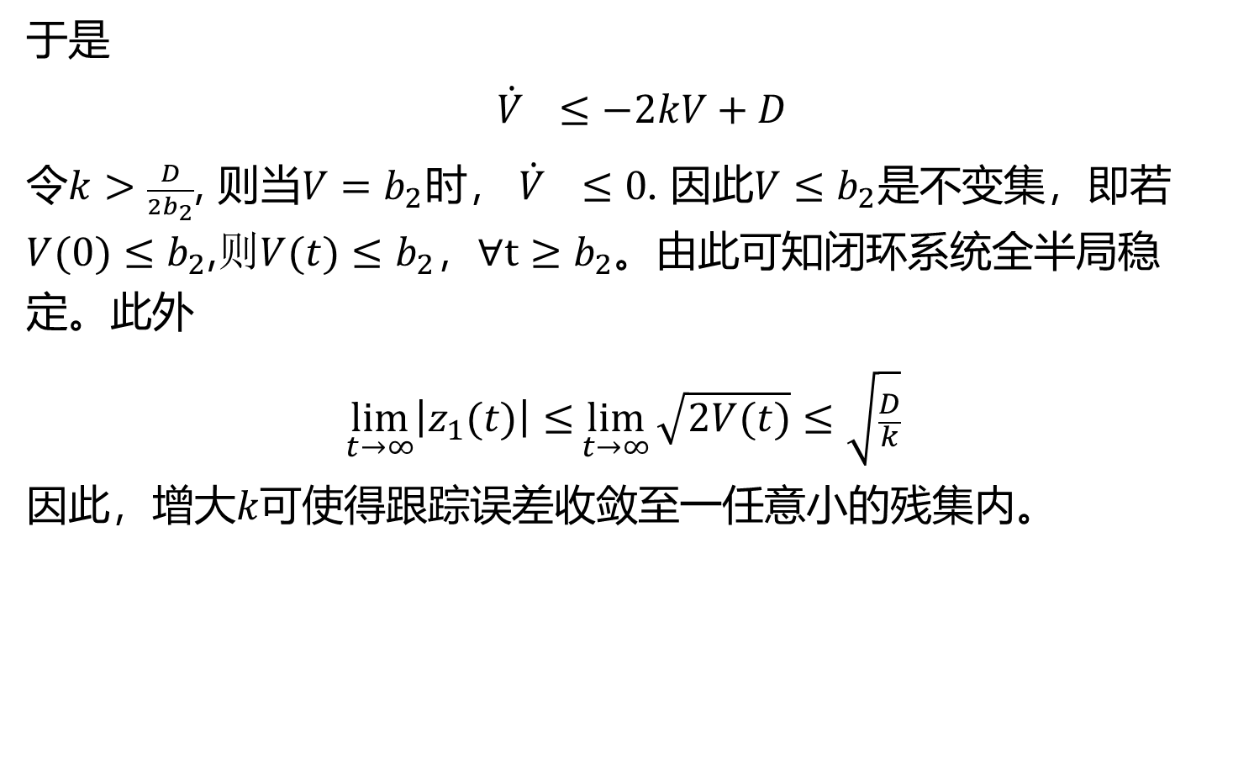
于是
${\dot{V}}_{}≤−2kV+D$
令$k>\frac{D}{2b_{2}}$, 则当$V=b_{2}$时， ${\dot{V}}_{}≤0$. 因此$V≤b_{2}$是不变集，即若$V(0)≤b_{2}$,$则V(t)≤b_{2}$，$∀t≥b_{2}$。由此可知闭环系统全半局稳定。此外
$$\lim_{t→∞}\left|z_{1}(t)\right|≤\lim_{t→∞}{\sqrt{2V(t)}≤\sqrt{\frac{D}{k}}}$$
因此，增大$k可使得$跟踪误差收敛至一任意小的残集内。

